Slide 1
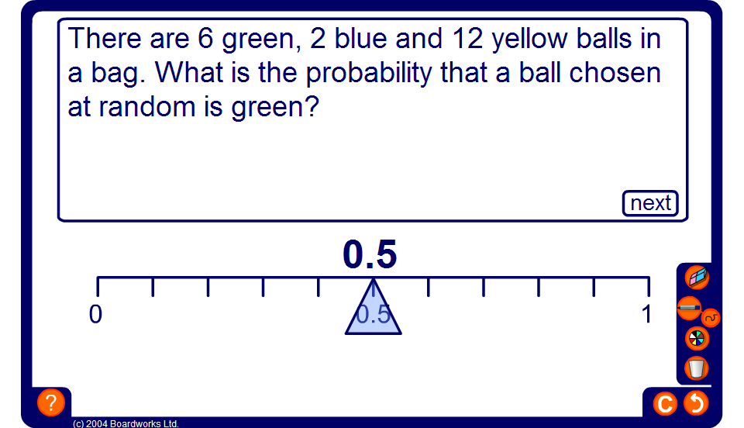


The probability scale
Notes:
Ask pupils to drag the pointer to the correct position on the scale.

